Slide 1
​RWCs audit
Pre INFCOM-3 Information Session
(2 April 2024)
Tanja Kleinert (Germany), Chair, Expert Team on WIGOS Tools and RWC Operations (ET-WTR)
Luis Nunes and Jitsuko Hasegawa, WMO Secretariat

Slide 2
General remarks
There will be 2 identical sessions:
02 April (06:30 - 07:30 UTC) - Eastern Hemisphere
02 April (14:30 - 15:30 UTC) - Western Hemisphere
The sessions will be recorded, and the recordings will be available on the INFCOM-3 website.
Second part of the session will be dedicated to your questions, please:
raise your hand,
use the chat, or
send an email (in any WMO language) to: lfnunes@wmo.int.
The working language is English, but we may try to address the questions in Spanish or French.
INFCOM-3 documents: INFCOM-3 -Session Information (wmo.int)

Slide 3
Outline of the Pre-Information Session
Item | Title | Speaker
1 | Introduction to RWCs functions and status of implementation | Luis Nunes (WMO Secretariat)
2 | RWCs audit programme and test/pilot audit with Argentina Proposed interim approach for assessment of RWCs (draft Decision 8.5(4)/2 (INFCOM-3)) | Tanja Kleinert (Germany)
3 | Proposed new Study Group on Centres Assessment, Designation and Compliance Review (draft Decision 8.5(4)/1 (INFCOM-3) | Jitsuko Hasegawa (WMO Secretariat)

Slide 4
Introduction to Regional WIGOS Centres functions and status of implementation
Background, concept and ToRs of RWCs
Functions of RWCs
WDQMS process
WIGOS tools
Roles and responsibilities
Status of RWCs establishment
Relevant documentation and learning material

Slide 5
1. Background, concept and ToRS of RWCs
The concept of RWCs was proposed by ICG-WIGOS in 2017, published in the Guide to WIGOS 2018 edition
Basic functions of the RWCs:
regional coordination, guidance, oversight and support to WIGOS implementation and operational activities at the regional and national levels
The operational implementation of RWCs was one of the 6 highest priorities of WIGOS Initial Operational Phase 2020-23
Since 2019, based on Member’s volunteer applications, RAs have designated various RWCs to cover either the entire Region or sub-regions
RWCs are hosted and operated by Members either in insulation or as network of nodes
Regional Associations (RAs) designate RWCs (pilot/operational)

Slide 6
2. Functions of RWCs
The RWCs mandatory functions are as follows:
1. (Regional) WIGOS metadata management (work with data providers to facilitate collecting, updating and improving the quality of WIGOS metadata in OSCAR/Surface),
2. (Regional) WIGOS performance monitoring, evaluation and incident management (WIGOS Data Quality Monitoring System – WDQMS) and follow-up with data providers in case of data availability or data quality issues.
Optional functions
Depending on available resources and regional needs, one or more optional functions may be adopted, e.g.:
(a) assistance with the coordination of regional/subregional and national WIGOS projects;
(b) assistance with regional and national observing network management; and
(c) support for regional capacity development activities.

Slide 7
3. The WDQMS process
Monitoring Function (NWP Centres)
Evaluation Function (RWC)
Incidents
process
Incident Manag. Function (RWC)
Retrieve
outputs
RWC
Check station
metadata
Assess &
Monitor
incidents
Analyze
results
WIS
Monitoring Webtool(s)
OSCAR/Surface
Incident Management Tools/procedures
Review, update
Station metadata
Request correction
Feedback
WIGOS TOOLS
National Contacts of RA Members
Users
NMHS Staff
WDQMS describes how well WIGOS is functioning
RWC evaluate the performances and initiate an incident procedure in case of non-compliance
Notes:
WIGOS monitoring function: WIGOS monitoring centres provide quality monitoring information on a 6-hourly basis
Quality monitoring reports as basis of the WIGOS monitoring function
Categories data availability, timeliness and data quality
Provide input to the WIGOS evaluation function.
WIGOS evaluation function: generates routine performance reports measured against reference sources
From the quality monitoring reports
From metadata about the observing stations, from the Observing Systems Capability Analysis and Review (OSCAR)/Surface tool,
From the WMO Information System (WIS).
WIGOS incident management function: takes up the issues that the evaluation function raised as incidents, and follows up actions with the data supplier to resolve the incident.

Slide 8
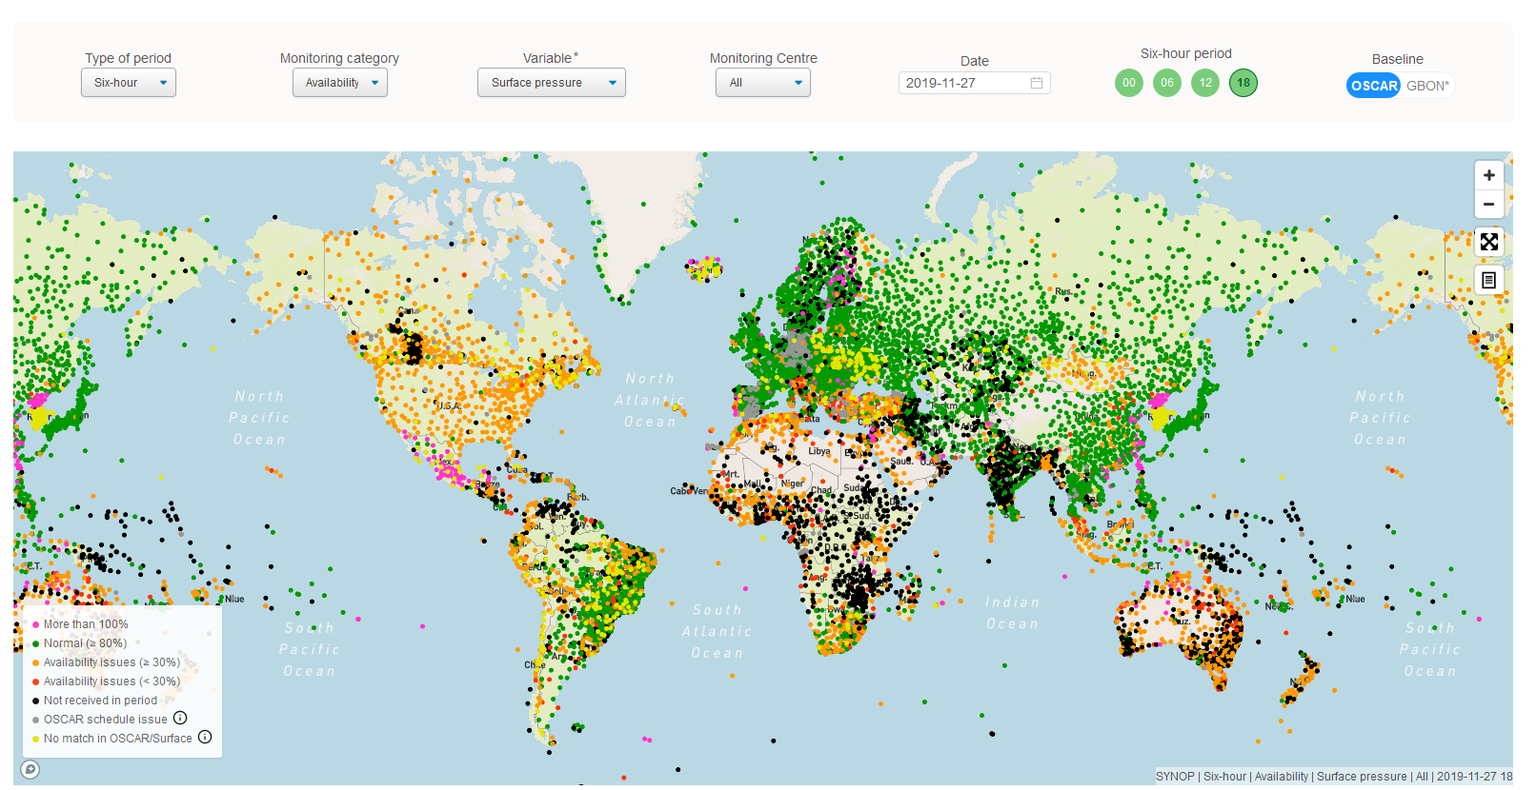
The WDQMS Web Tool (https://wdqms.wmo.int)
A web-based tool for monitoring availability and quality of observations exchanged internationally from Surface stations and Upper air stations
Further development going on based on requirements and specifications for the integration of additional observing systems/networks to be monitored, e.g. marine observations soon
Consists of three modules:
Near real time NWP monitoring; GBON availability; GCOS Networks
 | 8

Slide 9
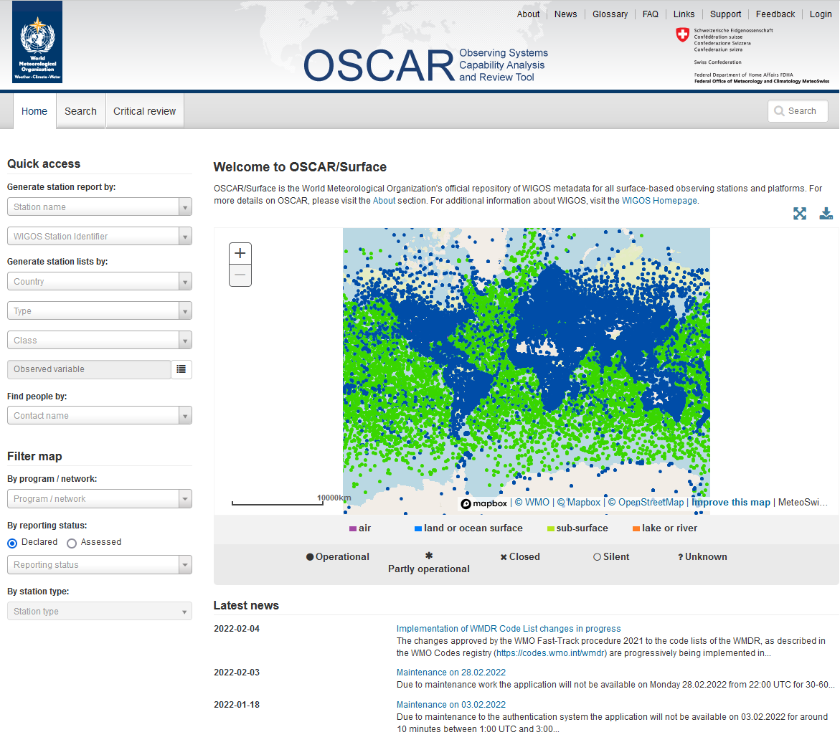
WIGOS Tool: OSCAR/Surface
OSCAR/Surface
Observing Systems Capability Analysis and Review Tool
https://oscar.wmo.int/surface/#/
 | 9

Slide 10
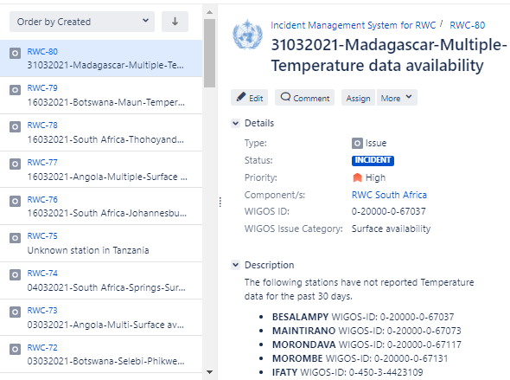
Incident Management System (IMS)
IMS
Incident Management System
A ticket system for performing the WDQMS incident management function
The first ever WMO centralized system describing performance issues with WIGOS data and metadata, in terms of quality and availability, allowing recording and tracking such issues
Hosted and operated by WMO
Being used operationally by 15 Regional WIGOS Centres nodes
 | 10

Slide 11
The WIGOS Tools releases
OSCAR/Surface
Observing Systems Capability Analysis and Review Tool
WDQMS
WIGOS Data Quality Monitoring System
IMS
Incident Management System
Operational since May 2016
Operational since March 2020
Several new releases expected per year
Current release 1.10.1 (March 2024)
Several new releases expected per year
Current release 1.4.5 (March 2024)
Operational system launched on 1 February 2024 (v.1.0)
 | 11

Slide 12
5. Roles and responsibilities
NFP for WIGOS = Coordinates WIGOS activities at national level
Member A
National level
NFP for OSCAR/Surface = Coordinates national activities related to WIGOS metadata in OSCAR/Surface
WIGOS NFP
WDQMS NFP
OSCAR/Surface NFP
Other NFPs . . .
NFP for WDQMS = Coordinates interaction with RWCs, through IMS and the actions at national level toward solving incidents with observations

Slide 13
Regional level
RWC staff:
- identify performance issues with observations exchanged internationally
- use the IMS to raise tickets, to follow up and to manage them;
- provide support and assistance to Members and Region/sub-region for their WIGOS implementation efforts
Member A
National level
RWC
WIGOS NFP
WDQMS NFP
OSCAR/Surface NFP
. . . .
Member C
National level
Member B
National level
WIGOS NFP
WIGOS NFP
WDQMS NFP
OSCAR/Surface NFP
WDQMS NFP
OSCAR/Surface NFP
. . . .
. . . .

Slide 14
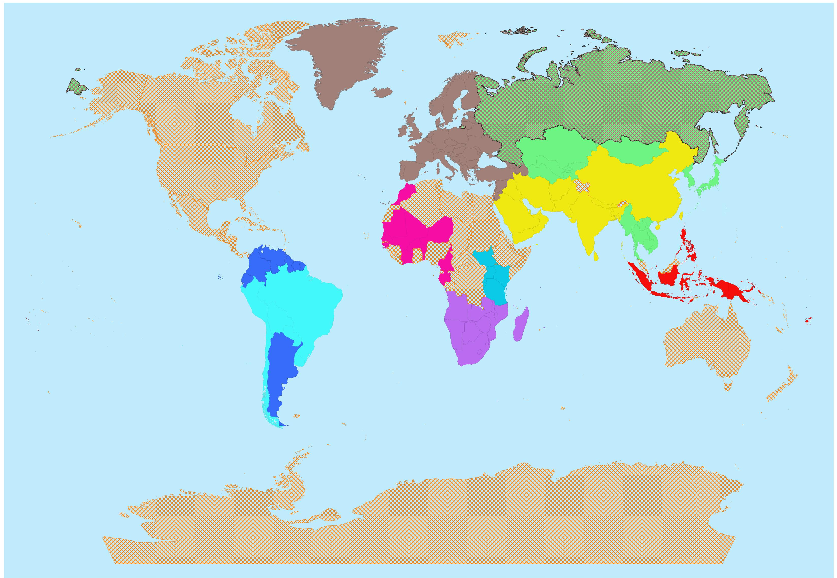
6. Status of RWCs establishment
RA IV:
Started pilot phase in Dec 2023 (BCT, Canada, Costa Rica, Trinidad & Tobago, USA)
RA VI:
Automatic monitoring function since 2018 (EUMETNET);
Establishment under progress with Bosnia & Herzegovina, Kazakhstan, Romania, Türkiye and EUMETNET (plus Russian Federation & Belarus)
RA III:
Pilot phase operations since May 2020 (Argentina and Brazil)
RA V:
Initial pilot phase since October 2021 (Indonesia and Fiji)
RA I:
East Africa - Pilot phase since July 2020 (Kenya and Tanzania),
Southern Africa - pilot phase since March 2021 (South Africa)
West Africa - pilot phase since September 2021 (Morocco)
RA II
RWC Beijing and RWC Tokyo, fully operational since September 2021

Slide 15
7. Relevant documentation and learning material
Relevant regulatory material:
Technical Regulations, WMO-No. 49: https://library.wmo.int/records/item/35722-technical-regulations?offset=5
Manual on WIGOS, WMO-No. 1160: https://library.wmo.int/records/item/55063-manual-on-the-wmo-integrated-global-observing-system?language_id=13&back=&offset=2
WIGOS Metadata Standard, WMO No. 1192: https://library.wmo.int/records/item/55626-wigos-metadata-standard?offset=7
Relevant guidance material:
Guide to WIGOS, WMO No. 1165: https://library.wmo.int/records/item/55696-guide-to-the-wmo-integrated-global-observing-system?offset=1
Technical Guidelines for RWCs on WDQMS, WMO No. 1224: https://library.wmo.int/records/item/56347-technical-guidelines-for-regional-wigos-centres-on-the-wigos-data-quality-monitoring-system?offset=1
Relevant learning material:
Available from the WIGOS Learning Portal: https://etrp.wmo.int/course/view.php?id=146
User Manuals:
OSCAR/Surface User Manual: https://library.wmo.int/records/item/56451-oscar-surface-user-manual?offset=1
IMS User Manual: https://library.wmo.int/records/item/57436-user-manual-on-the-incident-management-system-prototype-for-regional-wigos-centres?offset=1

Slide 16
Questions?

Slide 17
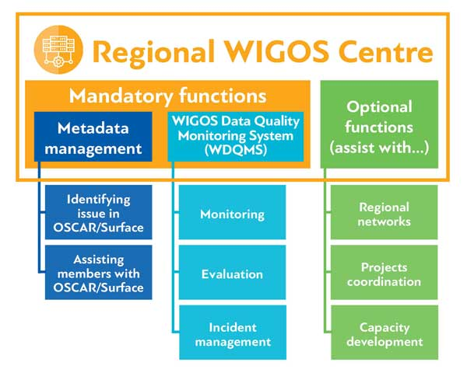
RWC Audits – to recall
Regional WIGOS Centres (RWC) are new WMO operational centres
Inter-Commission Coordination Group on the WMO Integrated Global Observing System (ICG-WIGOS) decided in 2019 that an accreditation process of RWCs should be established.
Currently, no common WMO process is in place on how to accredit WMO operational centres. Drafting the RWC audit process has been considered as a pilot project.
A RWC designation / reconfirmation process has been defined.
In collaboration with ET-AC (SC-IMT Expert Team on Audit and Certification) ET-WTR prepared a RWC audit programme on the basis of on-site audits.
INFCOM MG requested a ‘good enough approach’ conducting remote audits because it is unaffordable to conduct on-site audits for all operational centres.
GISC
WIPPS
RTC
…
RIC
RMIC
Notes:
Designation and reconfirmation process for RWC = Guide to WIGOS, Chapter 8, Annex 1
Global Information System Centres (GISCs)
Regional Training Centres (RICs)
Regional Instrument Centres (RICs)
Regional Marine Instrument Centres (RMICs)
Regional Specialized Meteorological Centres (RSMCs, now renamed as the WMO Integrated Processing and Prediction System (WIPPS) Centres

Slide 18
RWC Designation, assessment and reconfirmation process
Application
Evaluation of the application
Designation of RWCs in pilot mode
Evaluation of RWCs in pilot mode
Designation of RWCs in operational mode
Assessment
Reconfirmation of RWC
AUDIT
Guide to WIGOS
Chapter 8, Annex 1

Slide 19
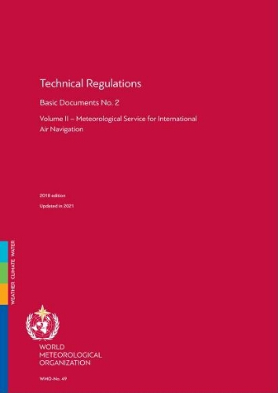
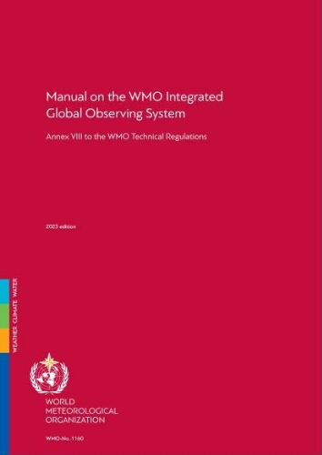
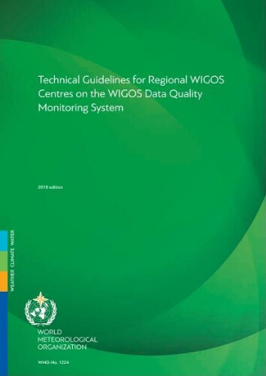
RWC Audit Programme
WMO Regulations and Guidelines
Audit objectives
Audit scope
Audit type
Audit method
Scheduling
Audit criteria
Risks and opportunities
Audit Team and Auditors
Relevant document information
WMO-No. 49
WMO-No. 1160
WMO-No. 1165
WMO-No. 1224

Slide 20
Audit Objectives
Assess compliance with
the RWC ToRs
the implementation options and resourcing
the principles and objectives of the corresponding RWC implementation stages
Determine conformity of the organization’s Quality Management System
Assess the resilience of Centre based funding and organizational commitment, resource commitment, and long-term planning.
Assess the monthly quality performance reports
Guide to WIGOS
Chapter 8.3 - 8.6

Slide 21
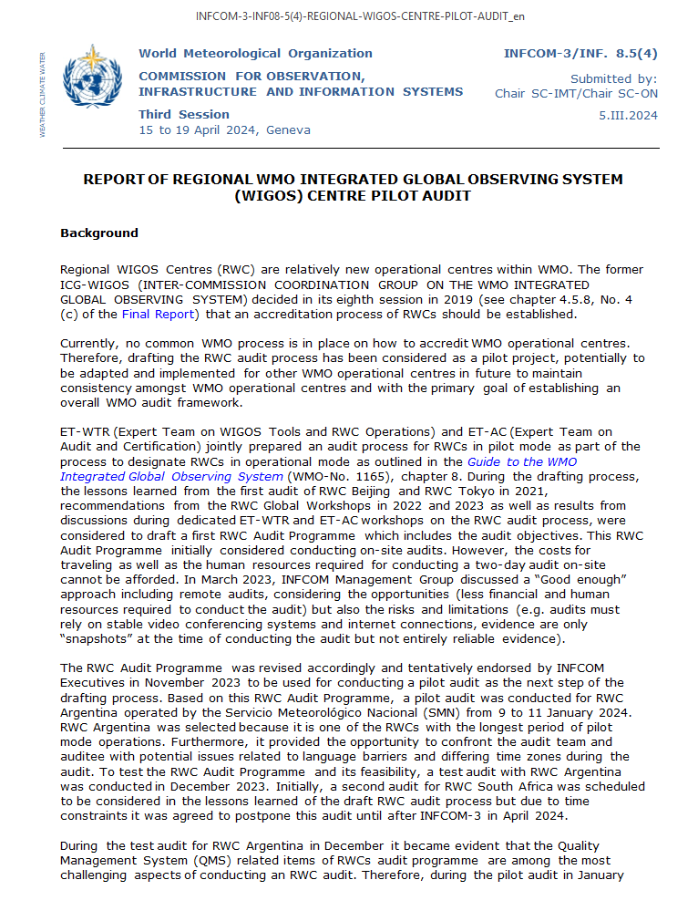
Test/Pilot audit RWC Argentina
INFCOM MG tentatively endorsed the RWC audit process in Nov 2023
18-20 Dec 2023 a test audit for RWC Argentina was conducted with the purpose to test the RWC Audit Programme and its feasibility
Pilot audit for RWC Argentina was conducted 09-11 Jan 2024
During the pilot audit in January 2024 the auditors only briefly touched on questions related to the QMS
The audit for RWC Argentina was successful ☺
Lessons learned from the audit and an estimate related to the required resources to prepare the RWC Audit Programme and to conduct the RWC audits have been summarized for further consideration by INFCOM, SC-ON and SC-IMT.
See INFCOM-3 INF document for more details: INF. 8.5(4) Report of Regional WIGOS Centre Pilot Audit

Slide 22
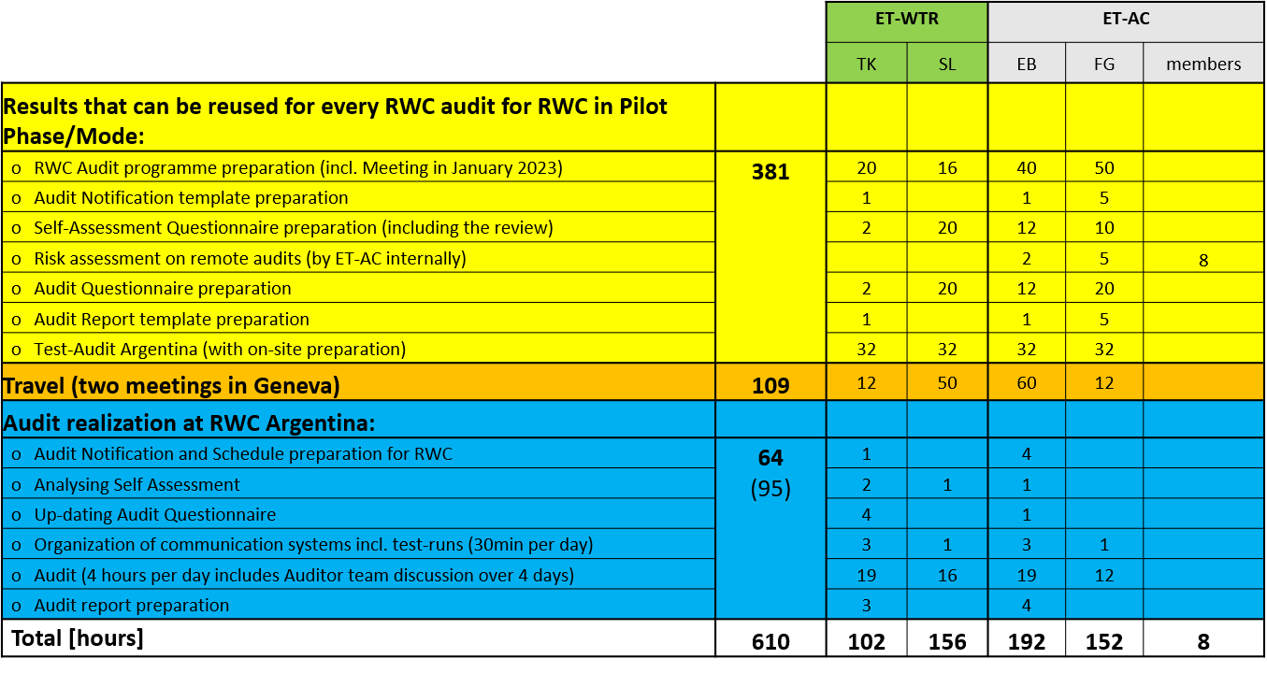
Lessons learned
Endorsement of the audit programme is essential.
The audit process outlined in the Technical Regulations (WMO-No. 49) can be executed.
Advance planning of the remote audit is required.
Although communication issues have been seen as one of the significant challenges, technical issues and language barriers could be solved / reduced.
Audit competency of Lead Auditors and Subject Matter Experts (SMEs) for RWC is essential to successfully conduct the audit → requires training for future auditors and SMEs.
Remote audits are feasible and can be used for other future RWC audits
Resources required to develop and conduct the RWC Audit Argentina have been estimated and can be used as baseline for adapting the pilot audit process to other WMO operational centres.
Efforts for the audit realization of the Lead Auditor and the SMEs will be reoccurring with every audit during the process designating RWCs in operational mode.
Remaining questions: certification process, discrepancies between WMO-No. 1165 and WMO-No.49, future evolvement of the RWC audit process, future RWC audits

Slide 23
Proposed way forward
To endorse the audit process to assess RWCs as an interim approach, until INFCOM-4
To establish audits teams to be composed by one auditor and one Subject Matter Expert (SME)
To follow a calendar of a maximum of four audits per year to be scheduled in consultation with Members hosting and operating RWCs in pilot mode
Revisit the RWC audit process in consultation with the new Study Group on Centres Assessment, Designation and Compliance Review (SG-ADCR)
Draft Decision 8.5(4)/2 (INFCOM-3)

Slide 24
Tentative sequence of RWCs audits
2024
South Africa
2025
Kenya
2026 and beyond
Brazil
Morocco
Tanzania
Indonesia
Fiji
British Caribbean Territories
Canada
Costa Rica
Trinidad and Tobago
USA
RA VI
RA I
Members should actively collaborate with the relevant RWCs, via their National Focal Points on the WIGOS Data Quality Monitoring System (WDQMS), and to nominate or to update their nominations as required, to make the operations of RWCs a success.
!

Slide 25
Questions?

Slide 26
Proposed way forward towards a generic approach for all types of centres
To establish a Study Group to draft generic principles for the process(es) for centres assessment, designation, and compliance review that are financially and operationally feasible for all types of centres under the responsibility of INFCOM in the long-term to be submitted to INFCOM-4
Proposed steps and considerations
Interpretation of the provisions on the demonstration of compliance of a QMS in the Technical Regulations
Assessment of the financial and operational feasibility of the RWC audit programme for all RWC
Assessment of the possibility of using alternative performance assessment mechanisms, including those used in existing mechanisms
Draft Decision 8.5(4)/1 (INFCOM-3)

Slide 27
Proposed way forward towards a generic approach for all types of centres
Existing mechanisms include:
The RWCs audit programme – consideration on the significant human and financial resources required to develop and maintain the audit programme and conduct such audits
Process for designation, assessment, reconfirmation of RICs (Resolution 17 (EC-73)) and RMICs (Resolution 36 (EC-76))
Including the survey of the WMO Members on needs and the utilization of and satisfaction with the services
Financial challenges faced by some RICs in achieving the recommended accreditation according to ISO/IEC 17025
Compliance review process for WIPPS Designated Centres (Resolution 28 (EC-76))
Two-step approach for compliance review and audit
considerable experts resources required to go through this process

Slide 28
Study Group on Centres Assessment, Designation and Compliance Review (SG-ADCR)
SG-ADCR will:
Provide the interpretation of the provisions on the demonstration of compliance of a Quality Management System and requirements for audit of the Annex to Part VII (1.4) of the Technical Regulations (WMO-No. 49) Volume I – General Meteorological Standards and Recommended Practices, and provide draft amendments to clarify the provisions if necessary;
Assess the financial and operational feasibility of the RWC audit programme for all RWCs to be designated in all Regions;

Slide 29
Study Group on Centres Assessment, Designation and Compliance Review (SG-ADCR)
SG-ADCR will:
Assess the possibility to use alternative performance assessment mechanisms such as user feedback, annual status reports submitted by centres and statistics of objective monitoring systems;
Draft generic principles for the process(es) for centres assessment, designation, and compliance review, including generic principles for certification and accreditation, that are financially and operationally feasible for all types of centres under the responsibility of INFCOM in the long-term;
Draft a recommendation on the substructure of INFCOM to support the development and implementation of the processes according to the generic principles.

Slide 30
Thank You
Questions?

